Slide 1
WELCOME
to

Slide 2
Healthcare IT Service
Complying with industry regulations, ensuring privacy, and streamlining healthcare.

Slide 4
MITIGATE SECURITY RISKS
MANAGED IT + SECURITY
Healthcare businesses need reliable IT infrastructure and healthcare IT consulting services that keep them on top of every complicated aspect of the industry, including HIPAA and HITECH compliance, Patientcare, insurance provider relationships, patient billing, and much more.

Slide 5
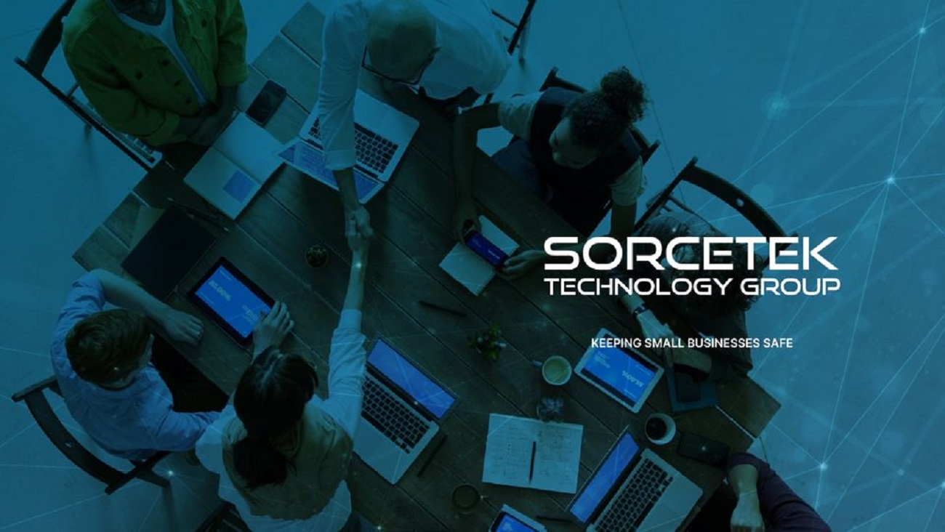
SorceTeck Technology Group, provide you with an actionable IT infrastructure roadmap that outlines all the important goals in their journey to a better IT Infrastructure. Once we start working towards a goal in the journey, we focus our efforts of improvement equally on three distinct aspects of the IT Infrastructure: the people that are intended to benefit from the system, the processes that are intended to be managed through the system, the technology that is intended to automate the system.

Slide 6
IT SERVICES OFFERINGS
Your business depends on reliable technology that just needs to work. We work with you to create a custom IT solution that fits your specific needs.

Slide 7
TOP SERVICES FOR HEALTHCARE TEAMS
IT CONSULTING
HIPAA COMPLIANCE
VIRTUAL DESKTOPS

Slide 8
IT Support & Consulting
You don’t need distractions. The right technology drives your business forward, but the daily monitoring, regular maintenance and troubleshooting can be burdensome.
We combine proactively heading problems off with solving any that arise.
Our support services mean we’re connected to you 24/7 so that you can focus solely on the mission and goals of your organization. Our services include taking support calls, installing software, regular maintenance, repairs, solving password issues, onboarding new employees and more.

Slide 9
HIPAA Compliance
Hardware maintenance is the cleaning, repairing, testing and upgrading of all physical components of your computer. This includes your hard drive, internal CD and DVD, monitor, mouse, keyboard and more.
Proper maintenance of your hardware extends the life of your computer and ensures it’s running at its most optimal. SorceTek’s hardware maintenance solutions focus on both the system-level and physical-level health of all your computer components.

Slide 10
Virtual Desktops
VIRTUALIZATION SOFTWARE
Virtual Desktops usually rely on virtualization software to mimic hardware capabilities. Operating systems, data and applications are abstracted from the computing device’s underlying hardware.
A desktop operating system runs inside a virtual machine (VM) that can be installed on an on-site server, a cloud server or on a PC. The main reason to run it on a PC is that it allows multiple desktops to be created.

Slide 11
Contact Us
Address: 6160 WARREN PKWY, SUITE 100 FRISCO, TX 75034
Contact: 8888192298
Website: sorcetek.com

Slide 12
Thank You

